Slide 1
DRAFT BUSINESS PLAN
Gallery M33

Slide 2
Summary
Gallery M33 is an innovative online communication platform for contemporary fine-arts direct sales and rentals.
Online, membership-based website that enables artists to communicate directly with customers through their personal art gallery as well as access self-service marketing, shipping, legal, accounting and communication services.

Slide 3
Structure

Slide 4
Main goals
Facilitate negotiations between artists and customers
Offer self-service business solutions to artists
Facilitate access and ease business agreements for customers in the most efficient manner.

Slide 5
Innovative management
Decentralized management:
Book keeping
Technical support
Customer service
Legal and accounting services
Partnerships have been negotiated with the following companies to facilitate shipping, handling, insurances and legal coverage of the artworks and artists: AXA Art, ShipArt, Fedex).
30 days payment guaranteed on escrow
Crowdsourcing management total integration by Y3:
Management
Fundraising
Marketing

Slide 6
Gallery M33 is a service organization that will remain flexible due to a structure that permits resilience and better adaptation capacity. Long-term value is built through its membership and visitor databases as well as online community building.
Outsourcing permits lower fixed labor costs as well as rapid reorganization skills in the event of new partnerships and alliances all adding to the competitive aspects of the organization.

Slide 7
Services
Art rental and sales
Contemporary sculptures, paintings, installations, photography and mix-media art.
➔

Slide 8
Services
Artist self-service (DIY) center
personal art gallery, self-service marketing, shipping, legal, accounting and communication services.

Slide 9
Key competitive factors
Membership-based
Fixed income
Easy financial monitoring
Low fixed costs
Community building
Referral systems
Offering of services currently unavailable in the market (blogue host, communication platform, self-service customized outsourcing)
Rentals are currently not offered at large by similar organizations

Slide 10
Prices - memberships
Silver: $15,95/mo
Gold: $30,95/mo
Platinum: $40,95/mo
*** Average membership: $29,28/mo

Slide 11
Prices - Art
Prices are set by artists for their artwork and are subject to management review before publishing.
Rental prices are set proportionally to prices. Rentals are available in three months increments.
Rental payments are tax deductible under operation costs for businesses.

Slide 12
Short term & long term goals
To become the leader in online fine art rentals and sales.
Objectives
Launch an online catalogue of 2000 artworks artists by October 31st 2011.
Build a membership of 1000 artists by March 30th 2012.
Develop a loyal customer following of individuals and business contacts.
Provide high quality artworks and high quality service for every customer.

Slide 13
Financial overview
Projected annual growth:
30% for memberships, 100% for services
Forecast Y1-2-3
Note: forecast are conservatives and do not include any additional revenue from outsourced services available to artists in the self-service station of the website.
Forecast Y1 revenue: ($5876)
1000 artist memberships, 50 crowdsource memberships calculated with average membership cost.
Forecast Y2 revenue: $2175
1300 artist memberships, 65 crowdsource memberships calculated with average membership cost.
Forecast Y3 revenue: $13819,45
1690 artist membership, 85 crowdsource membership calculated with average membership cost.

Slide 14
Production, procedures & policies
System of production management
Products (artworks) are made available by artists and referrals are encouraged to maintain a growing products and artists base.
Quality control procedures
Artworks are subject to curatorial policies
Legal contracts sales and rentals are available through Gallery M33
Policies (shipping, returns, Insurance) are available through Gallery M33
Credit, payment, and collections policies and procedures
All payments are processed through M33 PayPal accounts.
Products, shipping and handling costs must be put in escrow prior to shipping.

Slide 15
Market
Note: Etsy is one of the biggest successes in the online community today and market shares keep climbing.

Slide 16
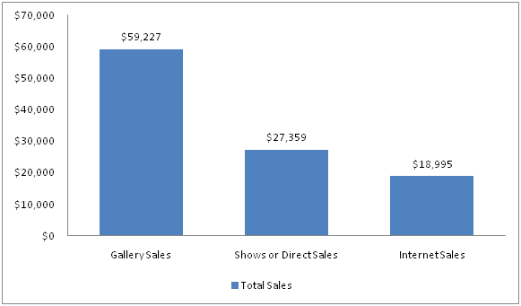
The opportunity
In spite of personal efforts to sell artwork directly to collectors, including shows and Internet marketing, a majority of artwork sold by successful artists continues to be sold through galleries (online and offline.
Both artists and collectors benefit from a reputable platform to interact and make sales and rental agreements. By building a community of trust, artists and collectors can build stronger long-term relationships.

Slide 17
A gallery in the 21st century has a chance to become a filter for collectors. To sift through the millions of online artists and bring them the highest quality work and giving them a reliable venue where they can confidently make a purchase.

Slide 18
Client database
Strategy for keeping client base
Website visitors are requested to sign-up to RSS feeds and newsletter
Artists are requested to submit referrals
Customer data is tracked and recorded, thank you e-mails and follow-ups e-mails as well as marketing e-mails on new artworks suggestions

Slide 19
Marketing plan overview
Short-term
Social media campaign
Ripple effects
Crowdmarketing
Long-term
Networking webs to feed an ultimately self-sufficient community where contribution is seen as added value
Long-term strategies include redistribution of profits by shares and the creation of an interlocking community of artists-managers, interactive customers and crowdsourced product specialists as well as automated out-sourced systems and pre-negotiated alliances

Slide 20
Conclusion
High quality artworks
+
efficient representation, communication & services
=
More sales, more rentals, returning customers & long-lasting relationships

